Slide 1
Welcome
Class of
2028
Personalizing Connecting Thriving
Parent information night

Slide 2

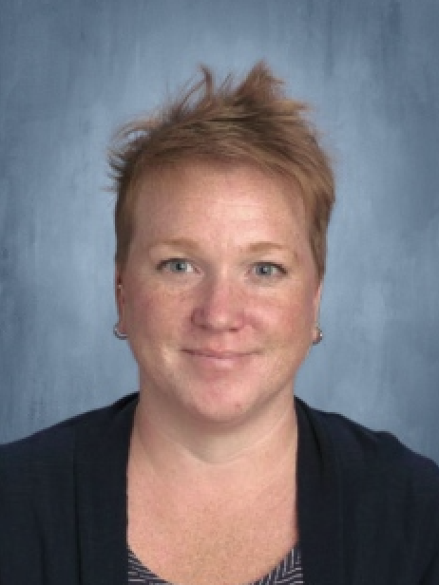
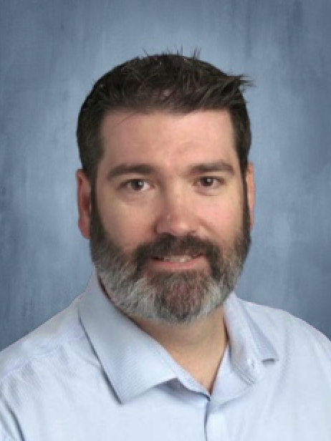
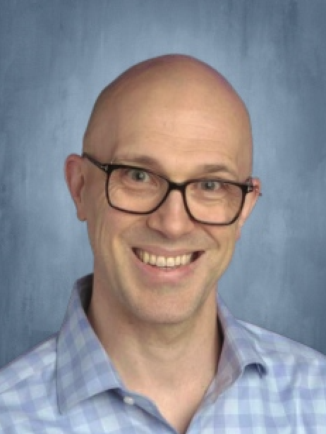
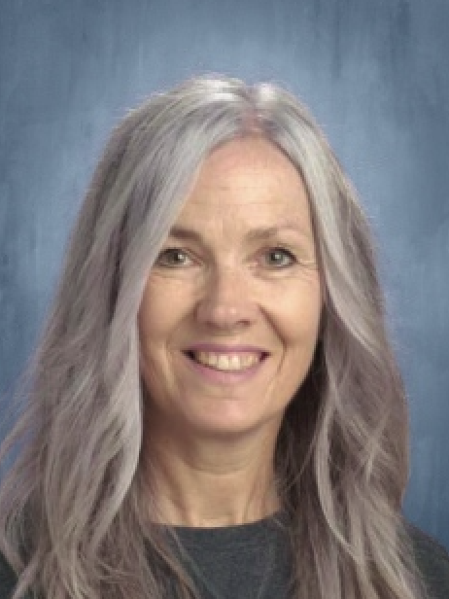
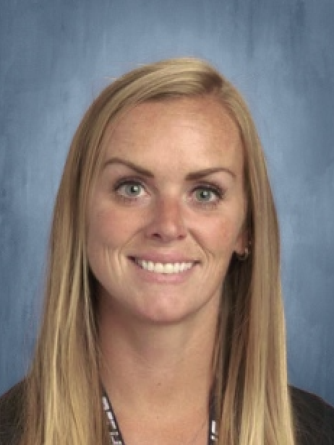
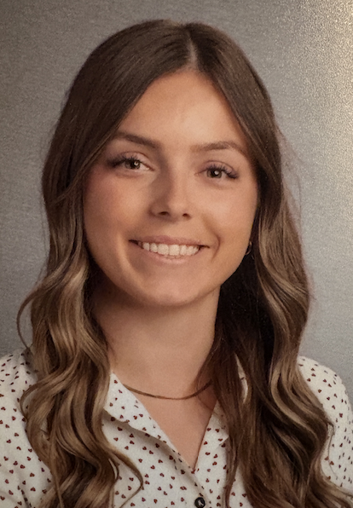
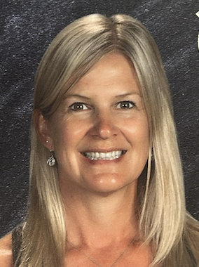
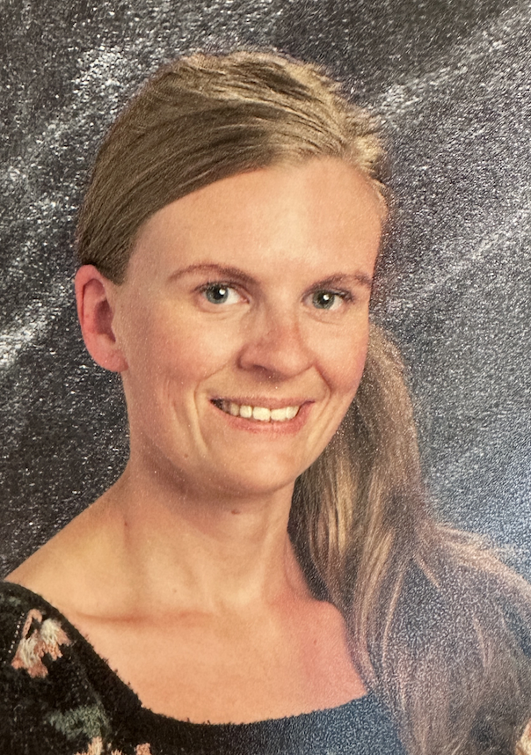
Meet your team
Ms Adams- AP
Mr Murray- AP
Mr Siegle- AP
Ms Hambidge
Ms Sellar
Ms Gentile
Ms Pretty
Principal

Slide 3
Community Model
What makes Thirsk unique?
Connect
Focus

Slide 4
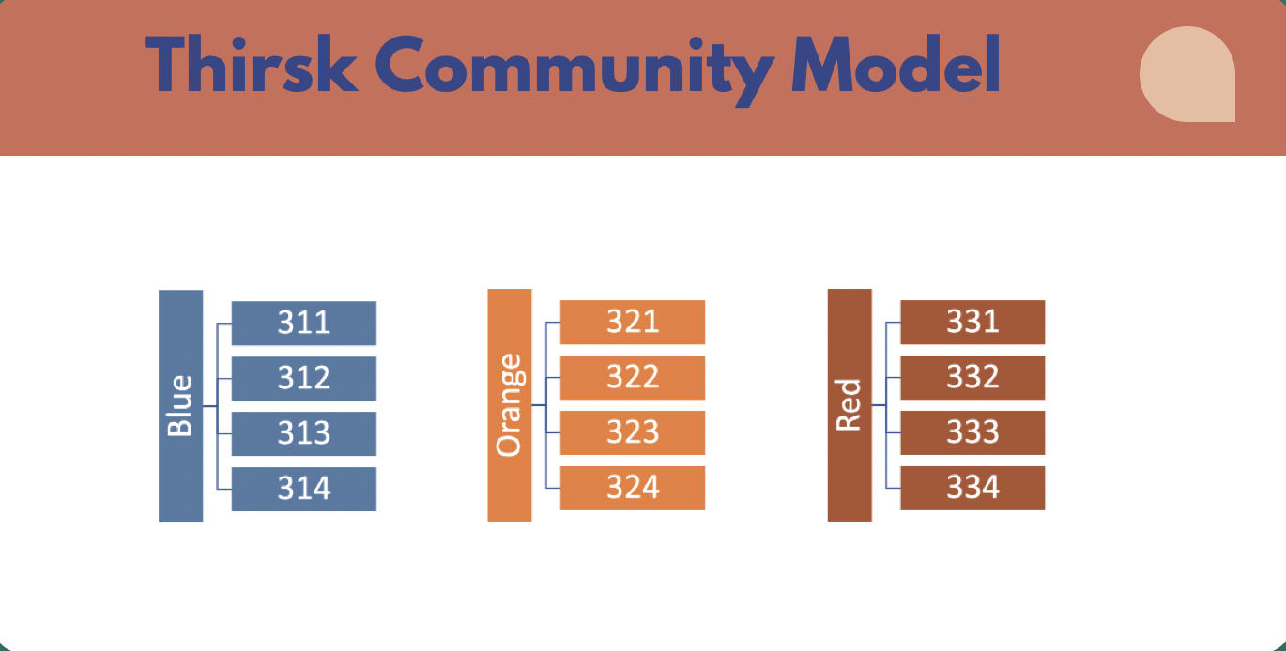

Slide 5
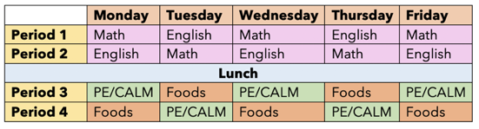
Daily Schedule

Slide 6
Phys Ed & CALM
Phys Ed 10 and Career & Life Management will be combined in one semester
Phys Ed 10 for 3 credits
CALM for 3 credits
Please do not take PE or CALM in the summer as you will still be in a class at Thirsk

Slide 7
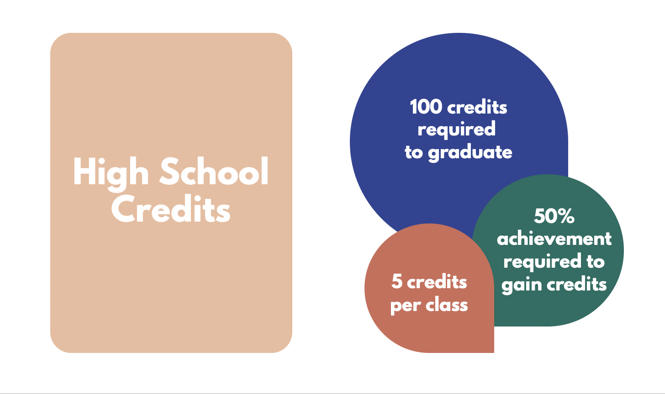
Gr 10 = 10 level → Science 10
Gr 11 = 20 level → Biology 20
Gr 12 = 30 level → English 30

Slide 8
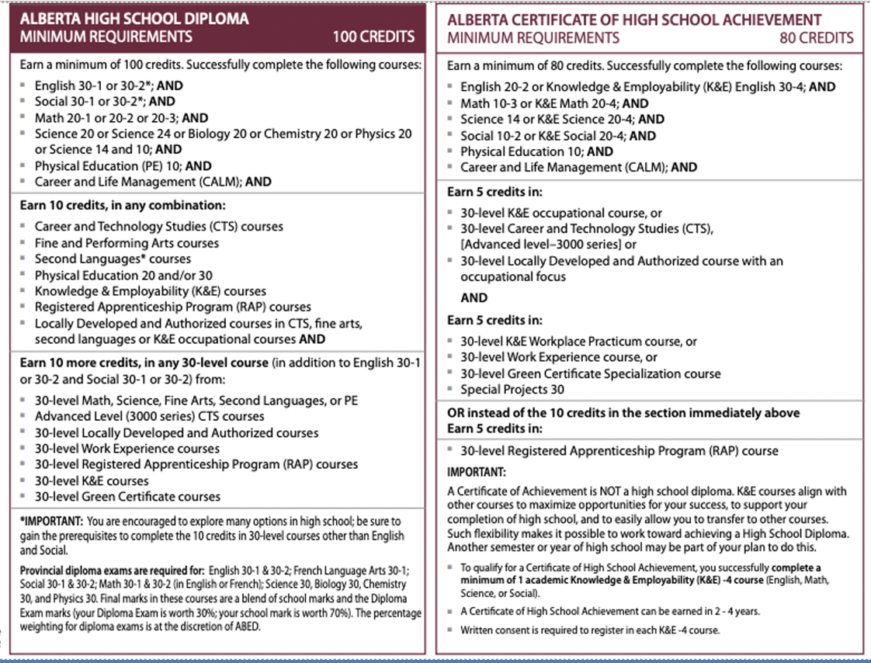

Slide 9
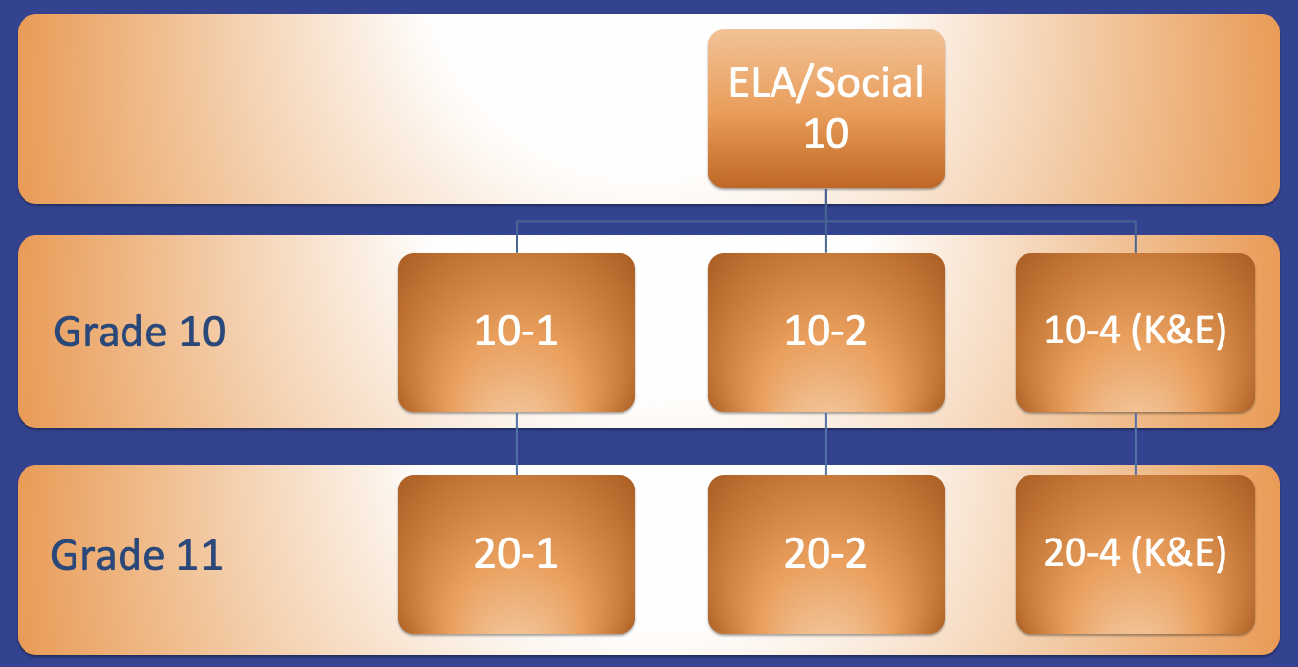
Blended Classes
ELA/Social

Slide 10
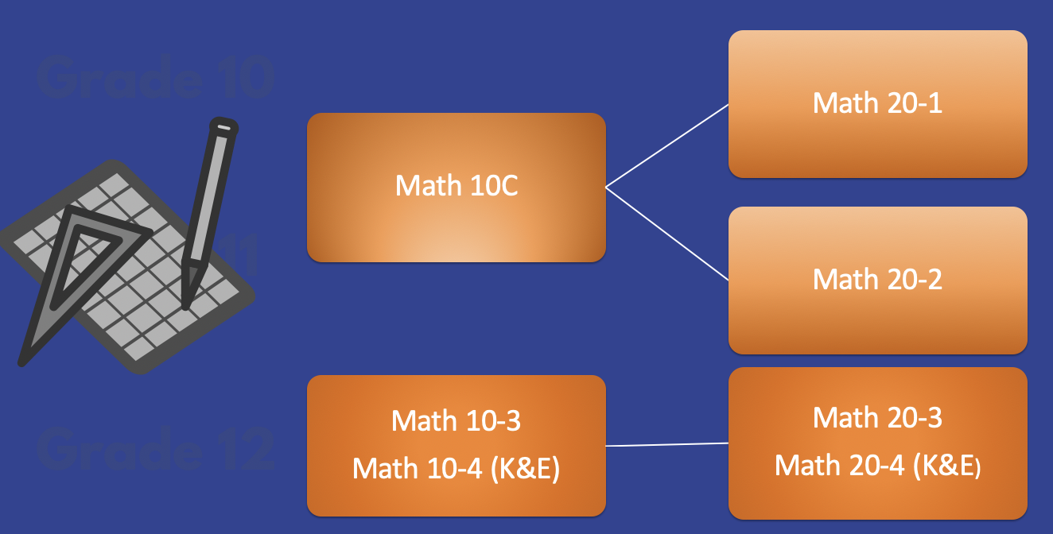
Math Sequencing

Slide 11
Math 15
We will be offering Math 15 as a complementary class which means it takes the place of an Option class
Math 15 will run Semester 1 only
Math 15 will be by teacher recommendation
Math 15 is the only summer school course for Gr 9’s so you are welcome to take it in the summer

Slide 12
Who makes a good candidate for Math 15?
Students who SHOULD take Math 15 | Students who should NOT take Math 15
Scored consistent 2s in Math 9 Need help transitioning into high school Goal of post-secondary We will be offering Math 15 as a complementary class (takes the place of an option) Must be recommended by Gr 9 math teacher | Scored consistent 3s and 4s in Math 9 (Math 10C recommended) Scored primarily 1s in Math 9. (Math 10-3 recommended) Student whose goal is to complete high school and then enter the work force. (Math 10-3 recommended)

Slide 13
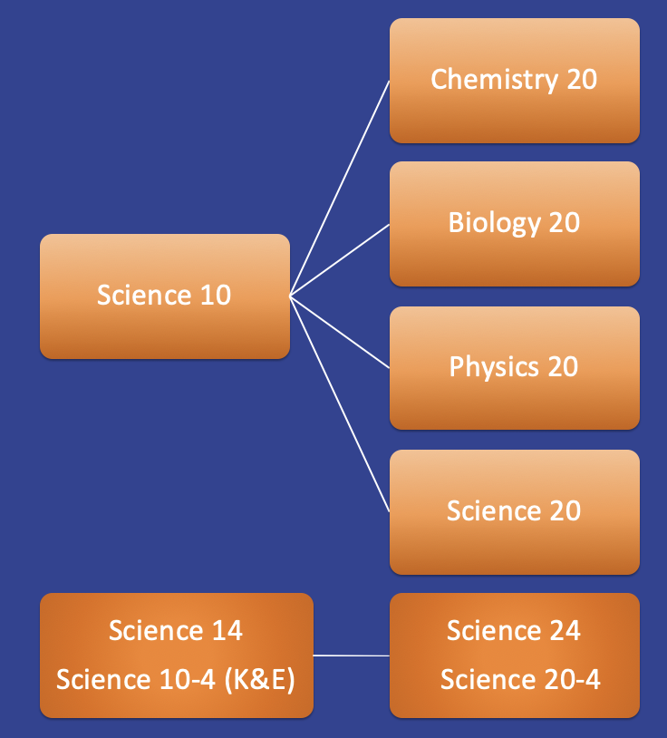

Science
Sequencing

Slide 14
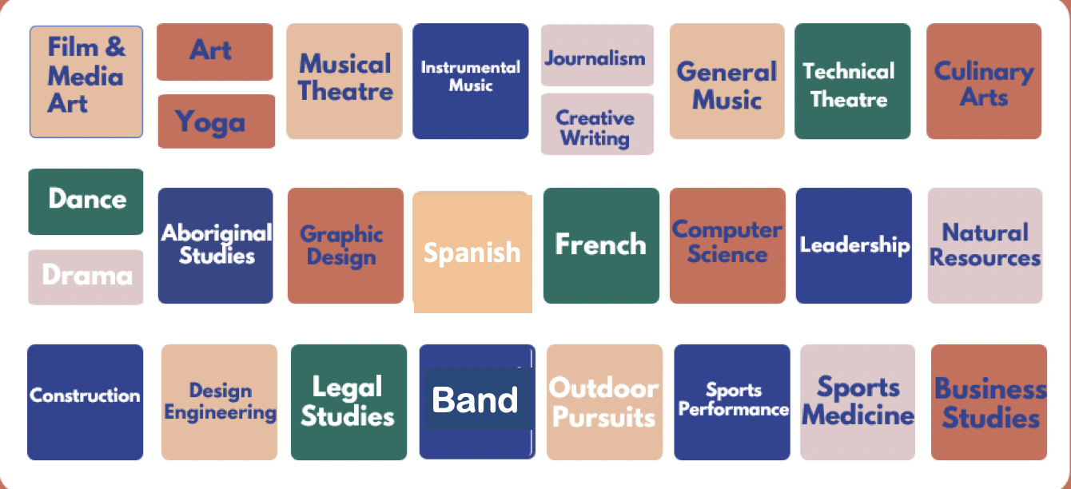
Complementary Courses (Options)

Slide 15
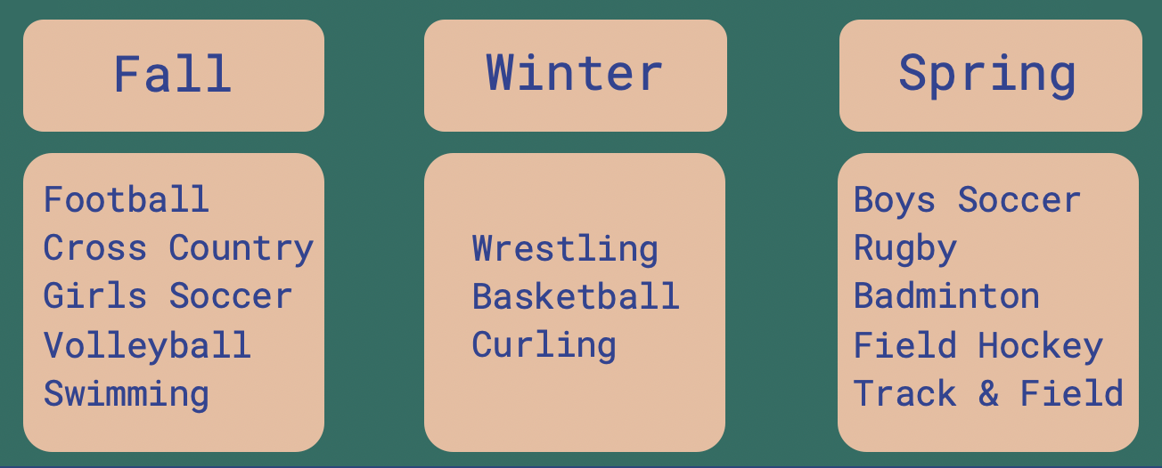
Athletics

Slide 16
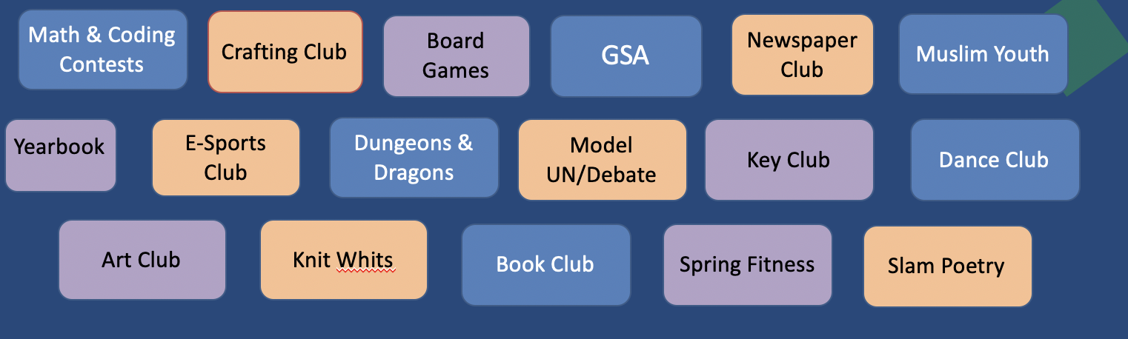
Extracurricular & Clubs

Slide 17
Advanced Placement AP
With the exception of ​ AP Computer Science (one semester),​ all AP classes ​ are year long | Art AP (Art 30/35) | Social Studies AP European History (SS 20-1/30-1/35) | English AP (ELA 20-1/30-1/35)
 | Biology AP (Bio 20/30/35) | Chemistry AP (Chem 20/30/35) | Physics AP (Physics 20/30/35)
 | Math AP (Math 30-1/31) |  | Computing Science AP (Comp Sci 30)

Slide 18
Language Options
Spanish Language Spanish 10-3Y ~ applicable for beginner Spanish learners Spanish 20-3Y ~ applicable for students who have completed Spanish classes in Junior High​ Spanish 30-3Y – applicable if you are coming out of Spanish bilingual school or Spanish speaking | French Language French 10-3Y ~ applicable for beginner French learners​ ​ French 20-3Y ​~ applicable for students who have completed French classes in Junior High​ ​ Direct entry into French 30-3Y ~ for previous French Immersion students or native French speakers. ​

Slide 19
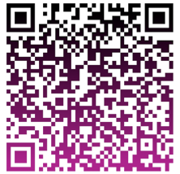
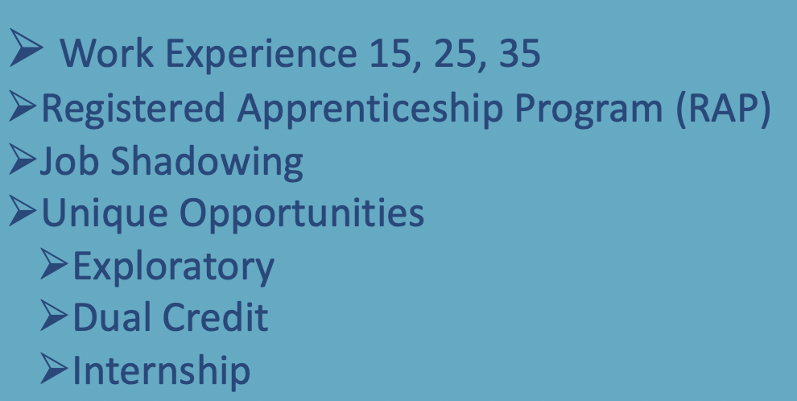
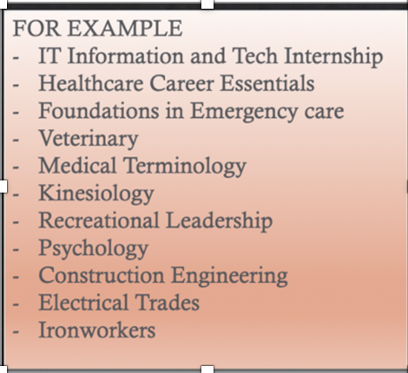
Off Campus Education Opportunities

Slide 20
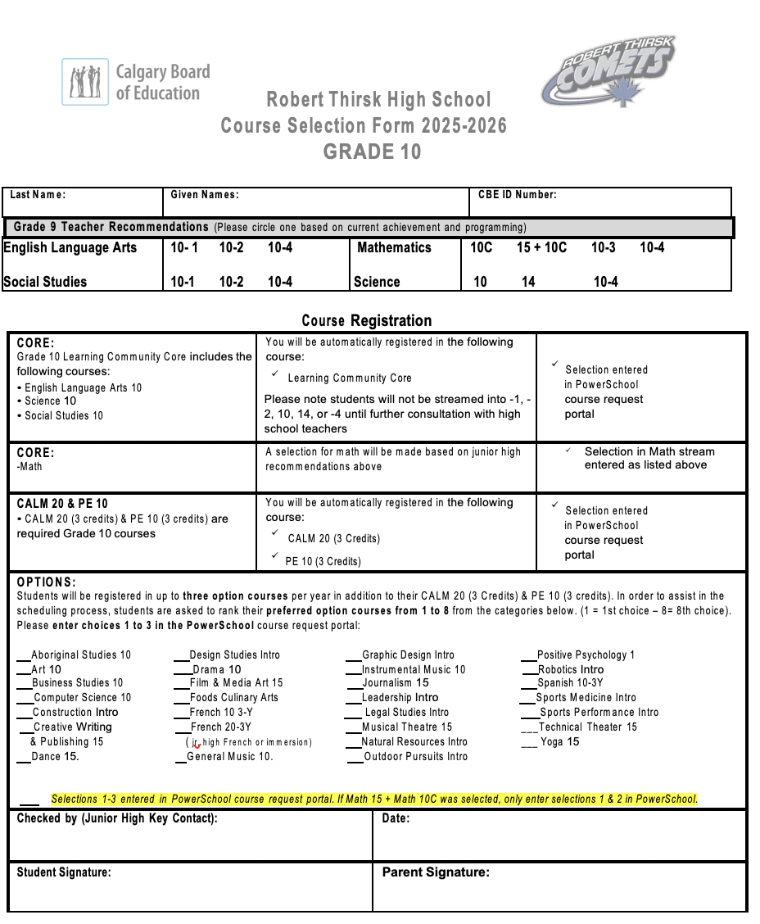
Registration

Slide 21

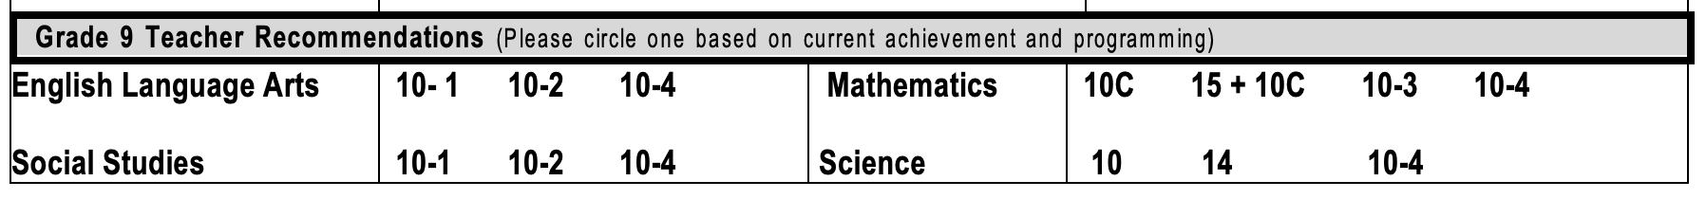

Slide 22
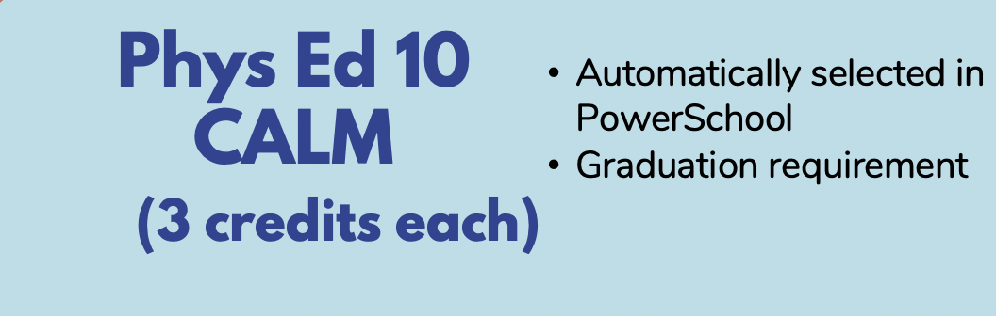
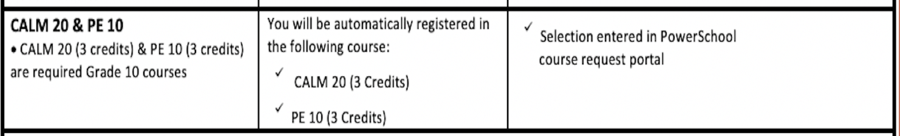

Slide 23
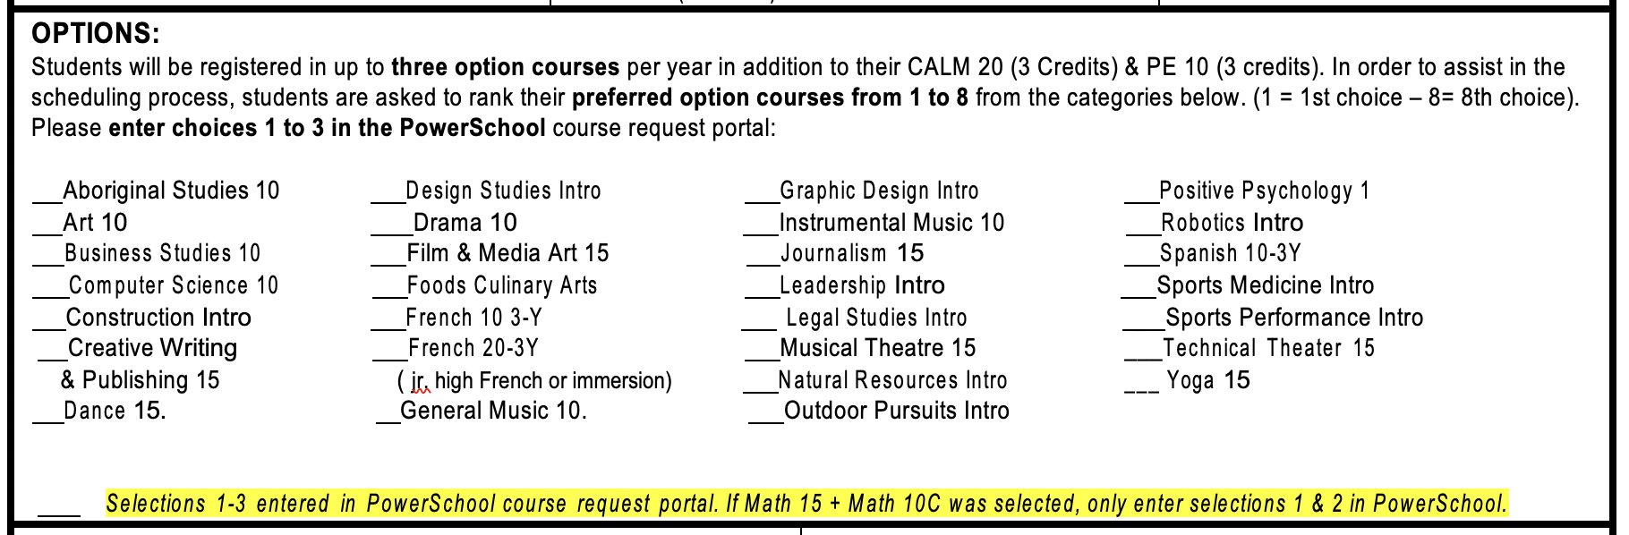
Complementary Classes
Choose 8 options on paper
1 = your most preferred
Enter TOP 3 in PowerSchool
Choose your options wisely

Slide 24
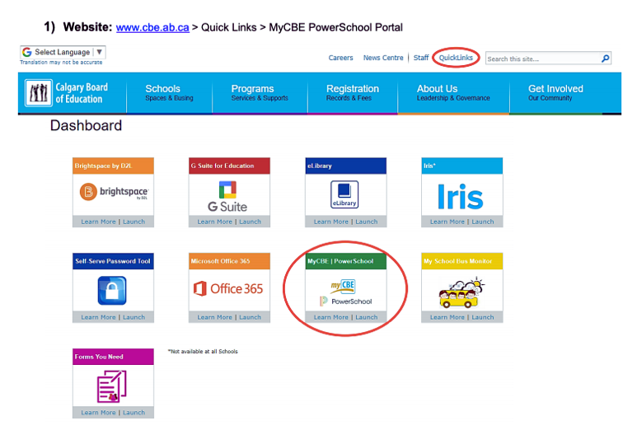
PowerSchool Registration
Cannot be completed in the app
Students are required to use a computer
Learning Community Core, PE & CALM will be automatically enrolled
Students will input 3 options

Slide 25
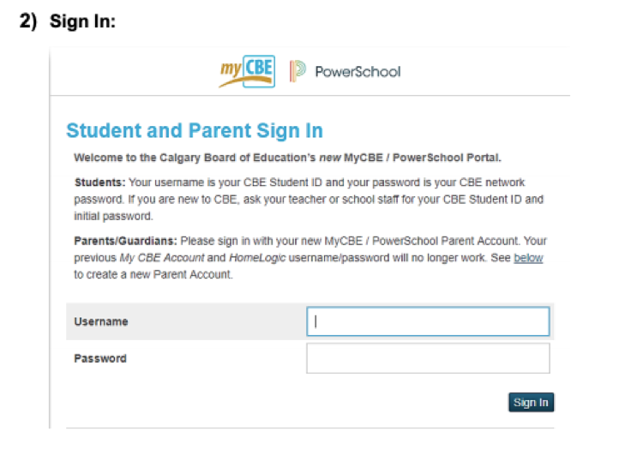
PowerSchool Registration

Slide 26
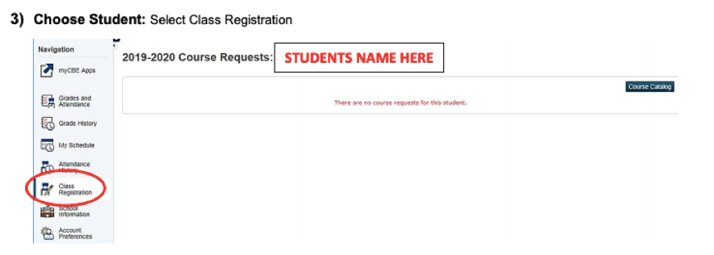
PowerSchool Registration
IMPORTANT: Even if you are thinking about transferring schools, please make your picks anyways
IMPORTANT: Even if you are thinking about transferring schools, please make your picks anyways
IMPORTANT: Even if you are thinking about transferring schools, please make your picks anyways

Slide 27
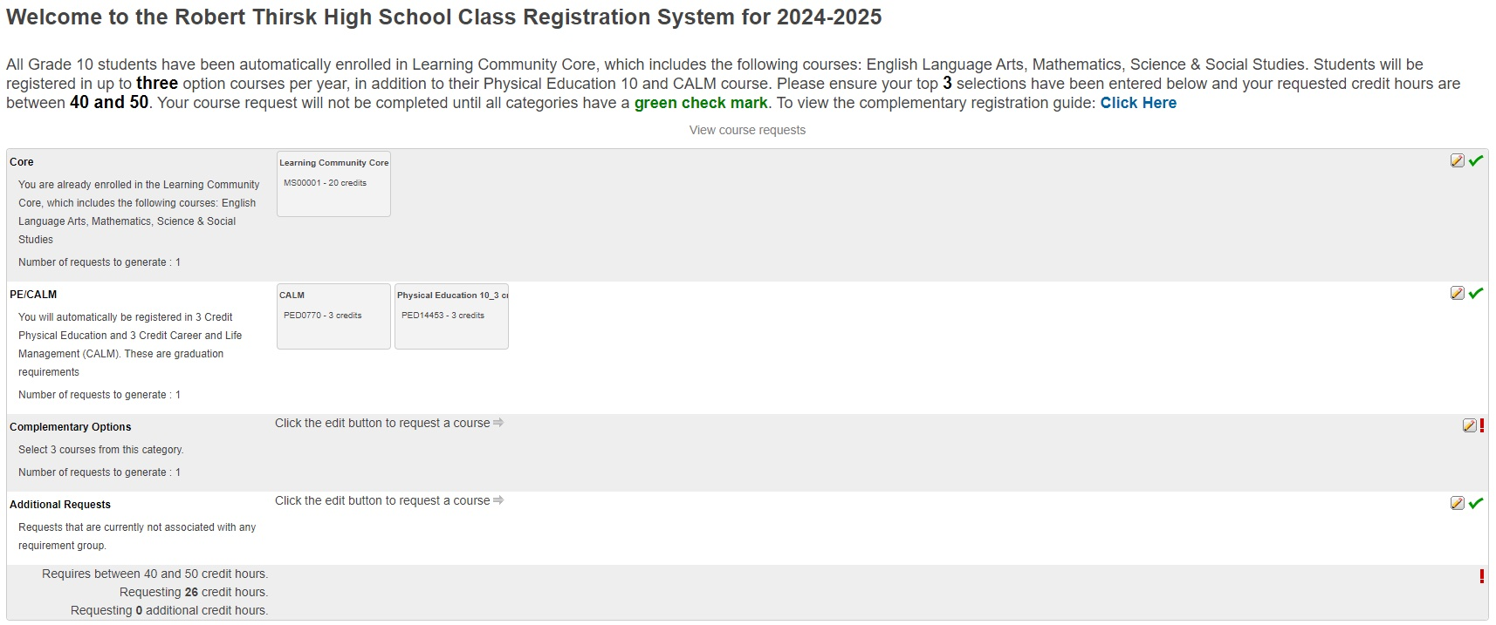
PowerSchool Registration

Slide 28
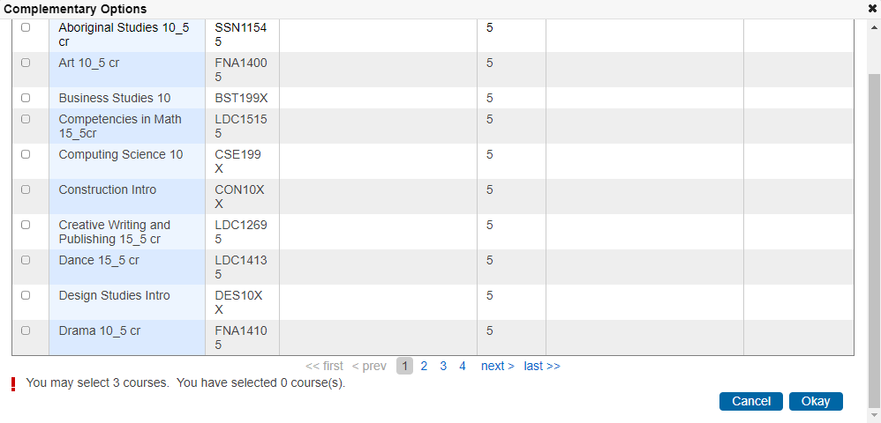
PowerSchool Registration

Slide 29
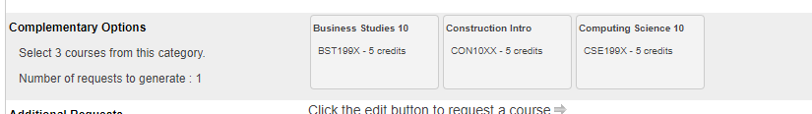
PowerSchool Registration
Once you pick your three Options, they should show up in the Complementary Options section like this

Slide 30
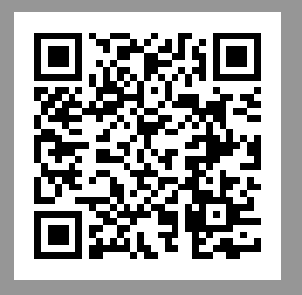
Transportation
There are express bus routes available from certain communities. See the QR code for the link to these routes
These routes are subject to change next year based on numbers and Calgary Transit
Determined by Calgary Transit

Slide 31
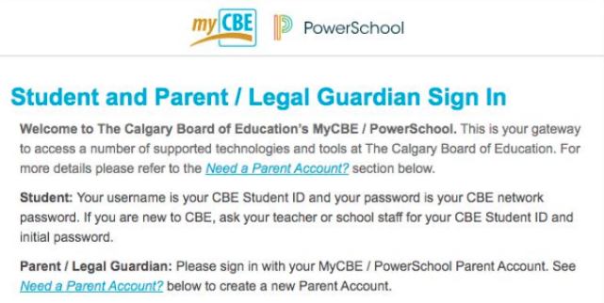
PowerSchool
Attendance recorded daily
Assessments regularly updated
Access to report cards as they are no longer printed
Student schedules
Your parent login information remains the same. You will be automatically designated

Slide 32
Important Dates
Feb 24: PowerSchool Opens for registration
March 5: PowerSchool Registration will be closed
March 5: Registration forms due to your teacher to be given to the high
school
March 15: Transfer deadline

Slide 33


Questions

